Slide 1


YOUTUBE SONGS ANALYSIS
WITH POWER BI
BY BANJO ESTHER O.
Data Analyst Intern
@

Slide 2
Project Overview
This project aims to conduct a comprehensive analysis of YouTube song data using Power BI.
The dataset contains key attributes such as video ID, channel title, title, description, tags, published date, view count, like count, favorite count, comment count, video duration, video definition, and caption details. The goal is to utilize Power BI to create insightful visualizations and reports that provide a deeper understanding of YouTube songs' performance, popularity, and user engagement. The analysis aims to uncover trends, preferences, and patterns in the data to aid content creators and stakeholders in optimizing their YouTube song content.

Slide 3
Data Description
The following are the columns available in the “songs” dataset used for this
project;
video_id: Unique identifier for each YouTube video.
channelTitle: Title of the YouTube channel publishing the song.
title: Title of the YouTube song video.
description: Description provided for the YouTube song video.
tags: Tags associated with the YouTube song video.
publishedAt: Date and time when the YouTube song video was published.
viewCount: Number of views received by the YouTube song video.
likeCount: Number of likes received by the YouTube song video.
favoriteCount: Number of times the YouTube song video has been marked as a favorite.
commentCount: Number of comments posted on the YouTube song
video.
duration: Duration of the YouTube song video.
definition: Video definition or quality (e.g., HD, SD).
caption: Availability of captions for the YouTube song video.

Slide 4
Analysis Objectives
Data Cleaning and Preparation:
Clean and preprocess the dataset, handling missing values or
outliers.
Convert relevant columns to appropriate data types.
2. Exploratory Data Analysis (EDA):
Explore patterns and distributions in view counts, like counts, and
comments.
Identify trends in the popularity and engagement of YouTube song videos.
Content and Channel Analysis:
Analyze the distribution of videos across different channels.
Identify popular tags and their correlation with view counts.
4. Temporal Trends:
Explore how YouTube song video metrics vary over time.
Identify peak publishing times and their impact on engagement.
5. User Engagement Insights:
Investigate relationships between likes, comments, and views.
Identify factors influencing user engagement with YouTube song videos.

Slide 5
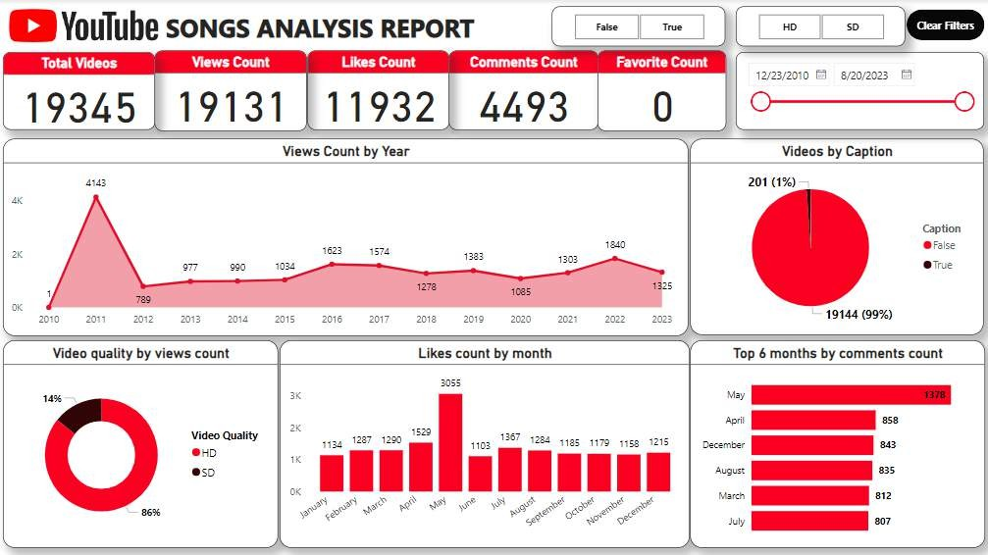

Slide 6
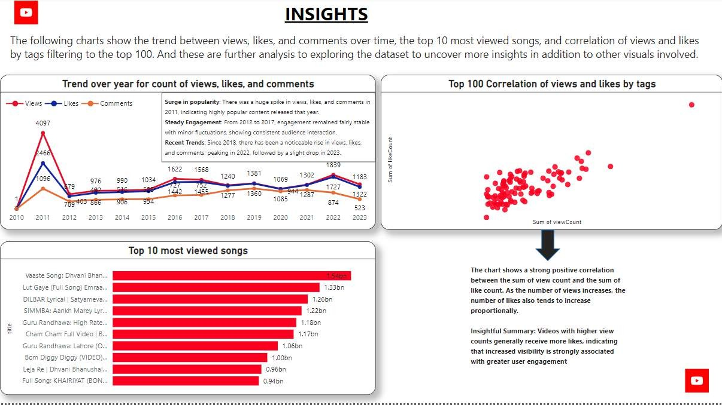

Slide 7
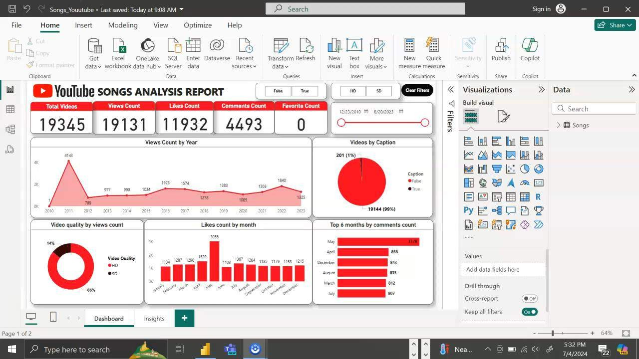
Dashboard Interactions

Slide 8
Recommendations
The following points are recommended for improvement of activities on YouTube songs;
Engage viewers through comments and description
Use relevant tags to enable search visibility
Maintain a consistent posting schedule
Encourage content creators to create videos with quality
Analyze metrics and trends regularly to understand the type of content that surges more over a certain period of time
Investigate the relationship between likes, comments, and views across tags, video quality, and caption.

Slide 9



THANK YOU

